Slide 1
Copy Data to Azure SQL

Slide 2
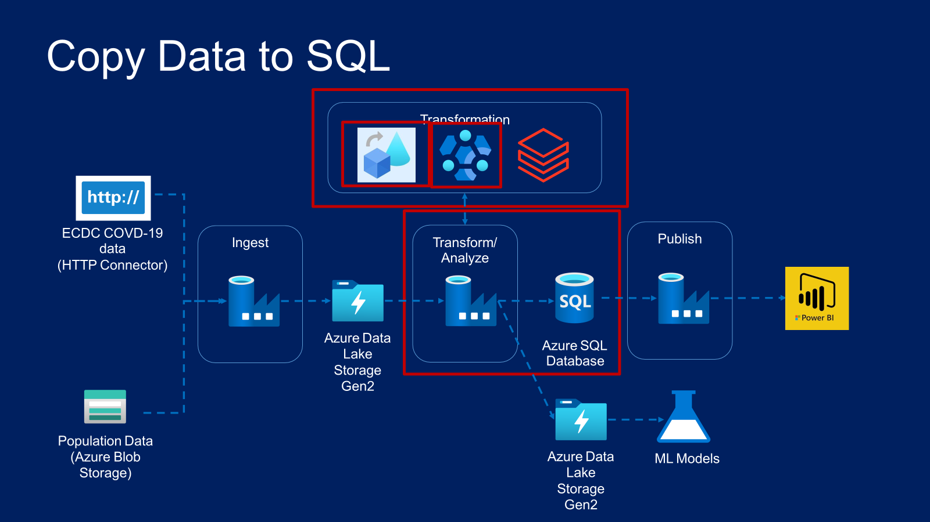

Slide 3
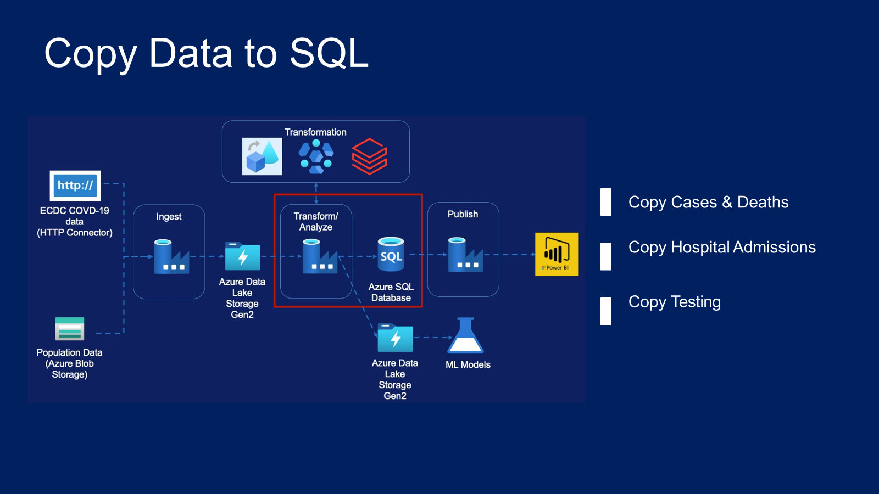

Slide 4
Copy Activity – Data Lake to SQL
Cases and Deaths Data

Slide 5
Copy Activity – Data Lake to SQL
Hospital Admissions Daily Data

Slide 6
Copy Activity – Data Lake to SQL
Testing Data

